Slide 1

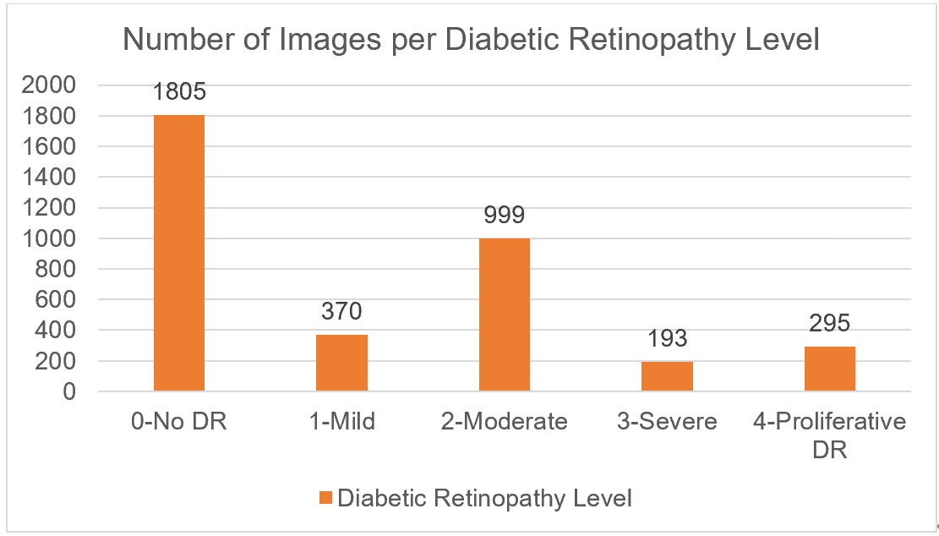
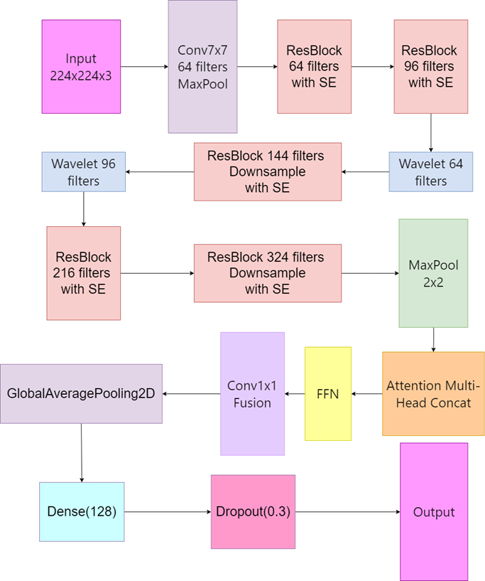
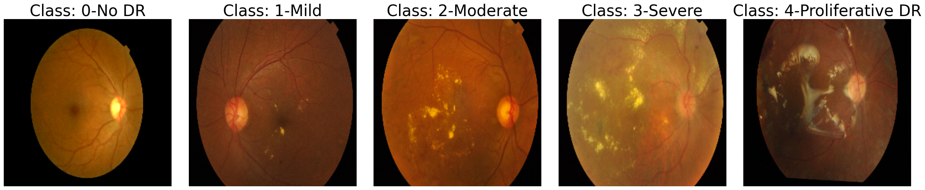

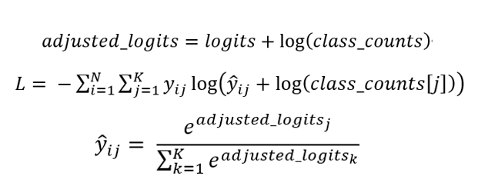
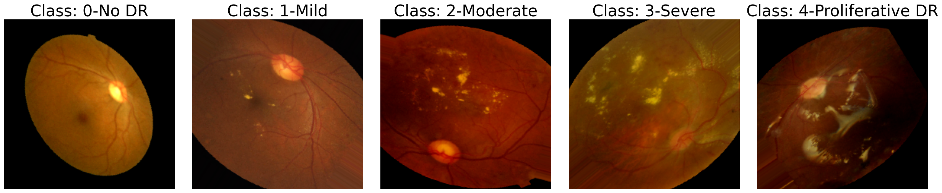
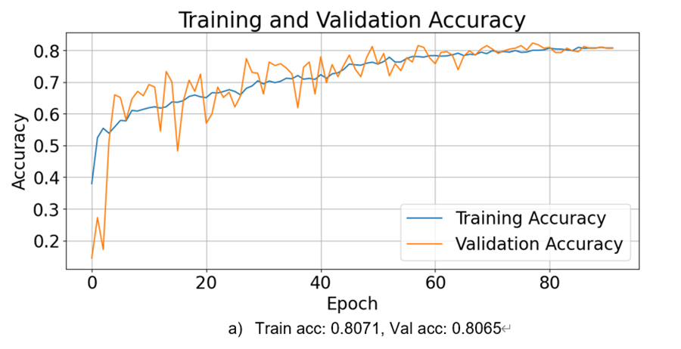
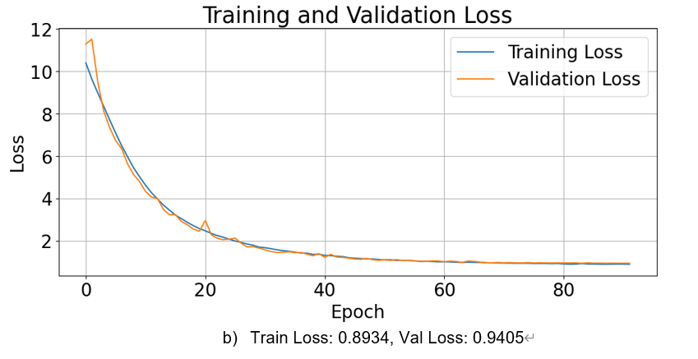
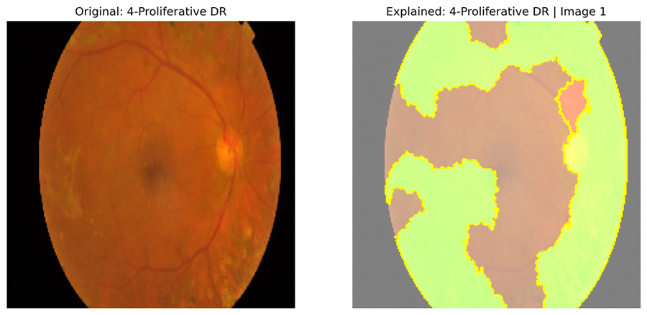
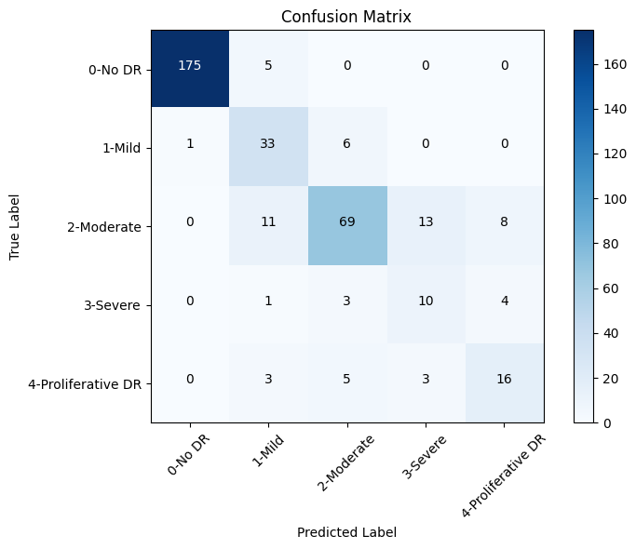
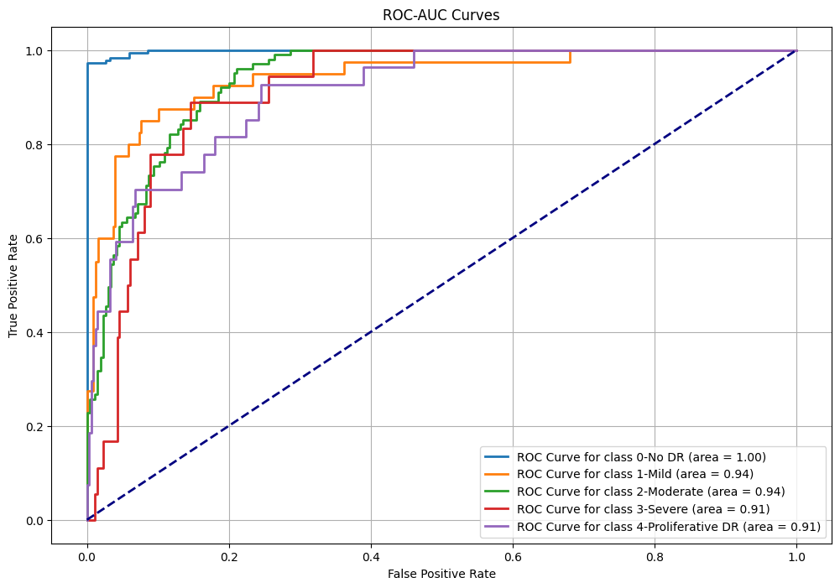
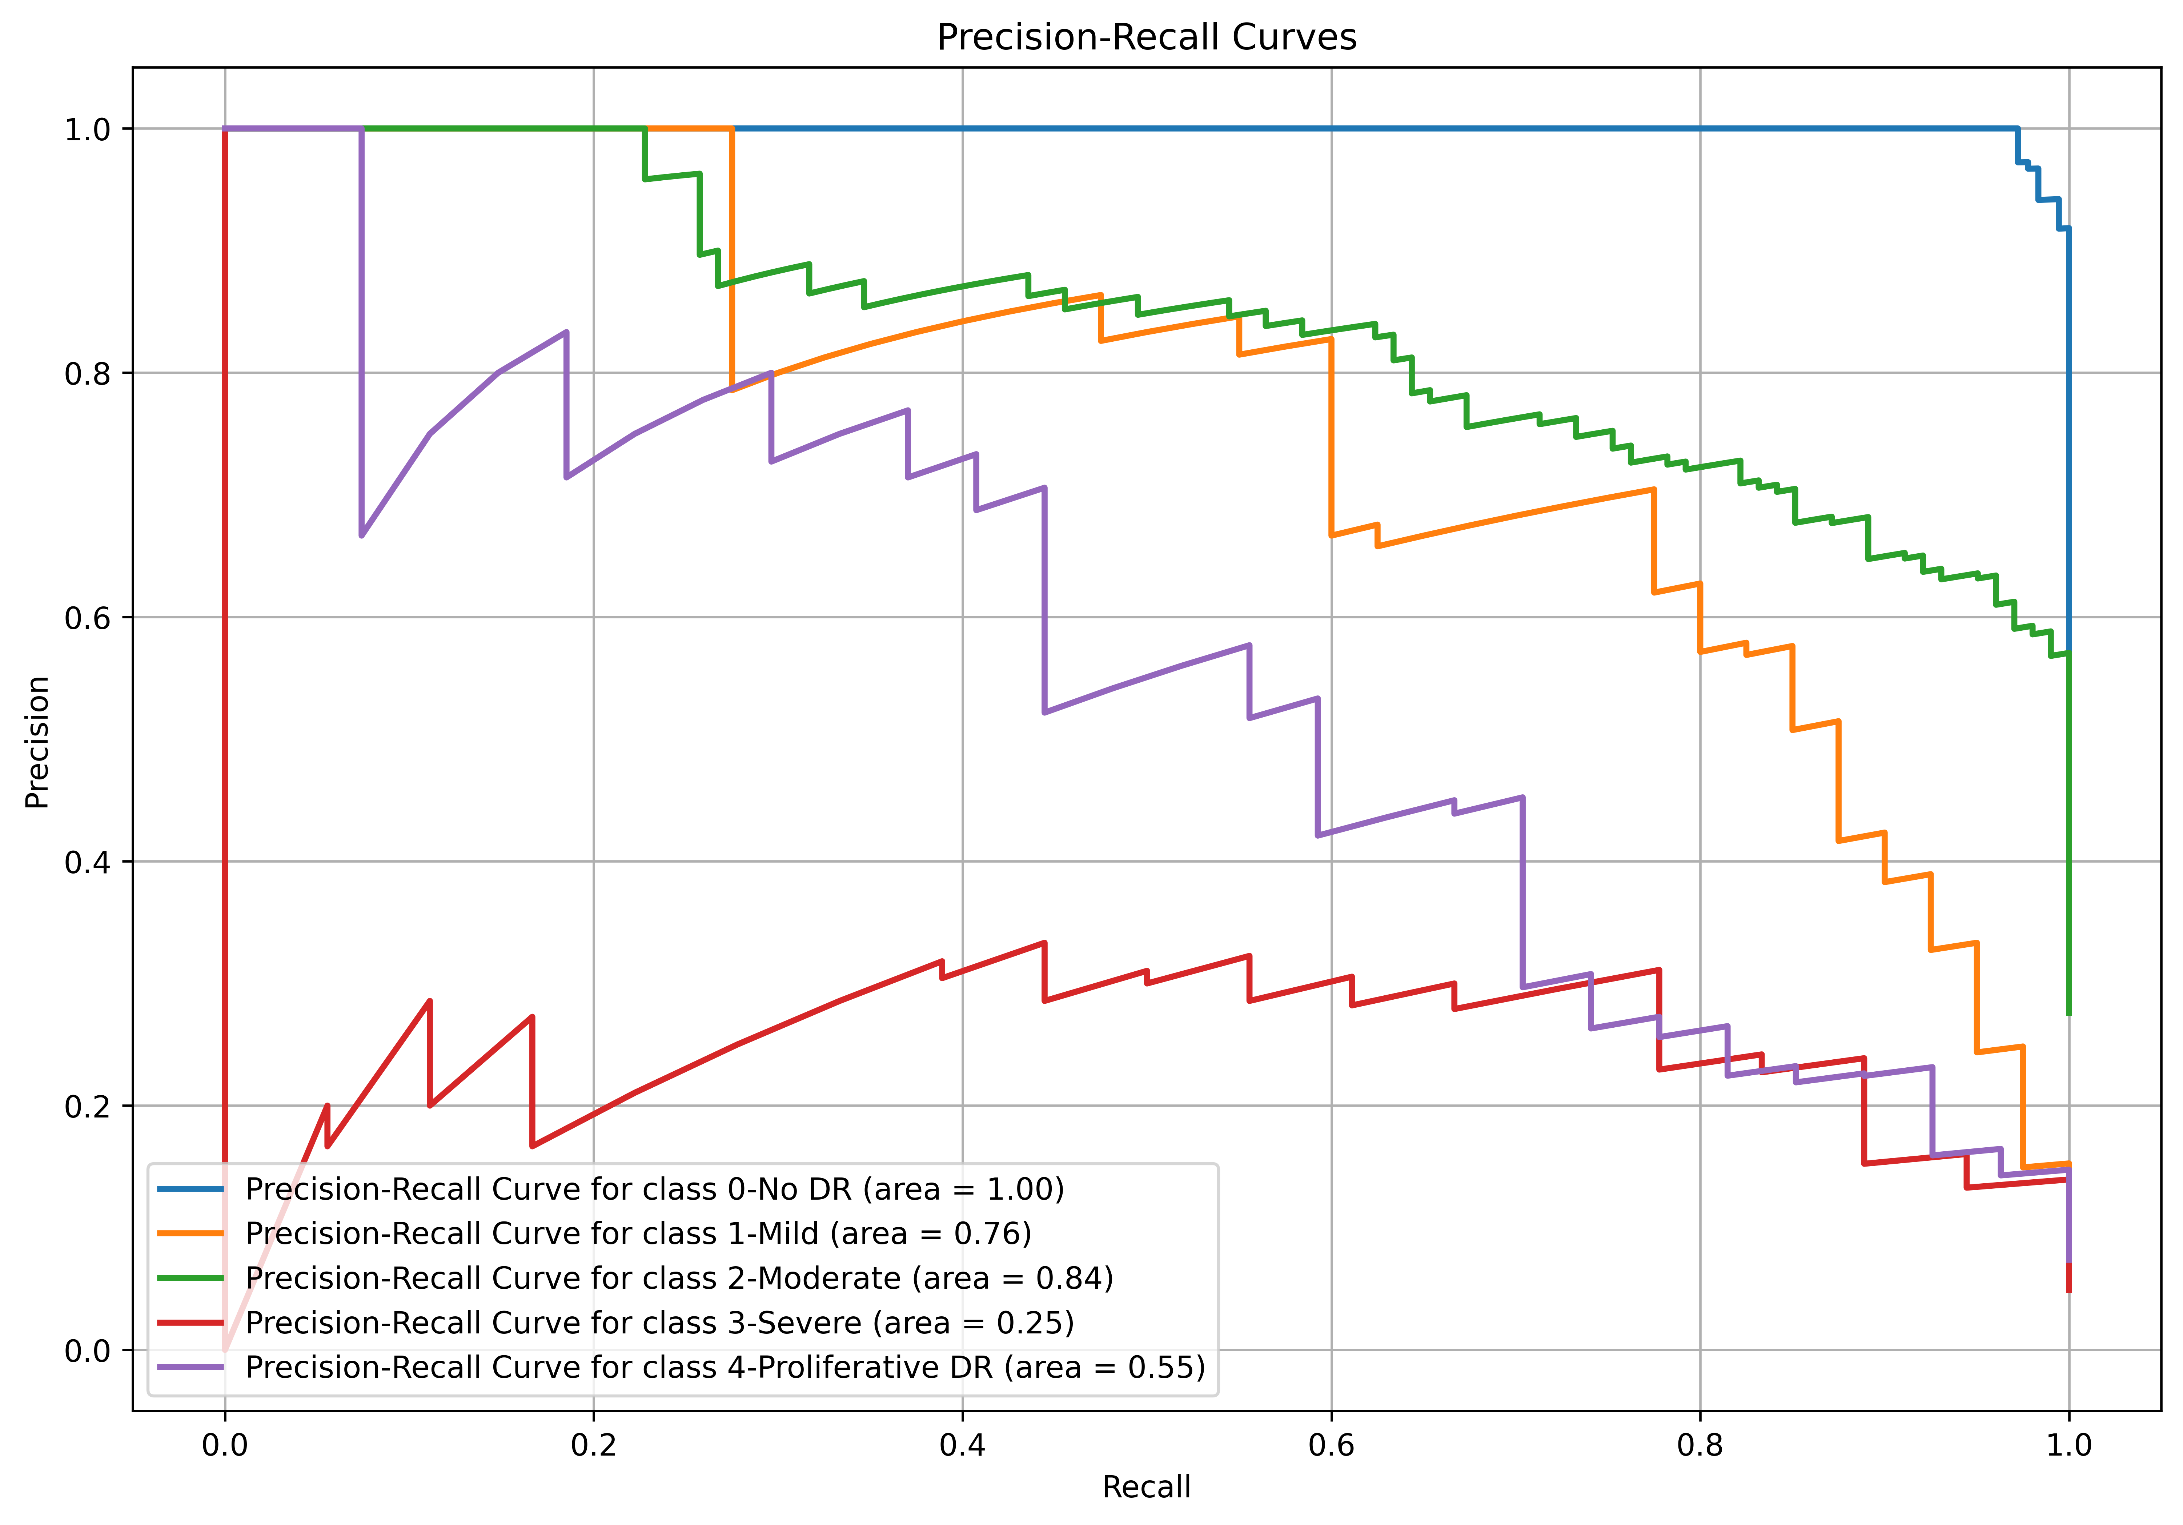
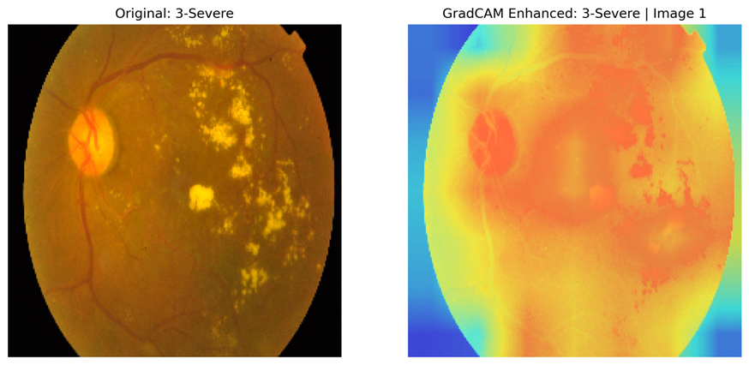
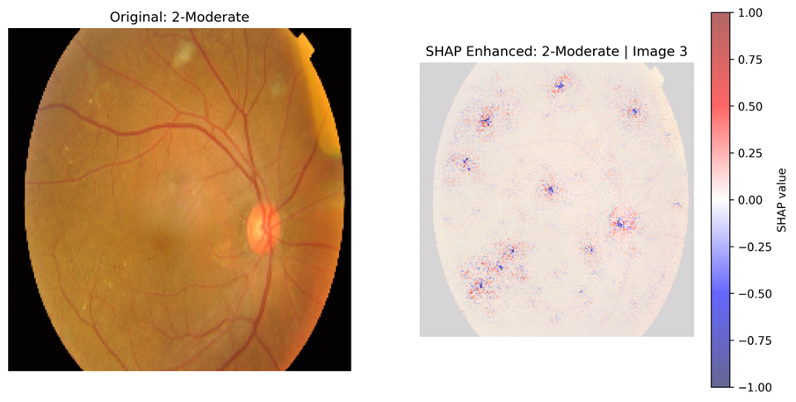
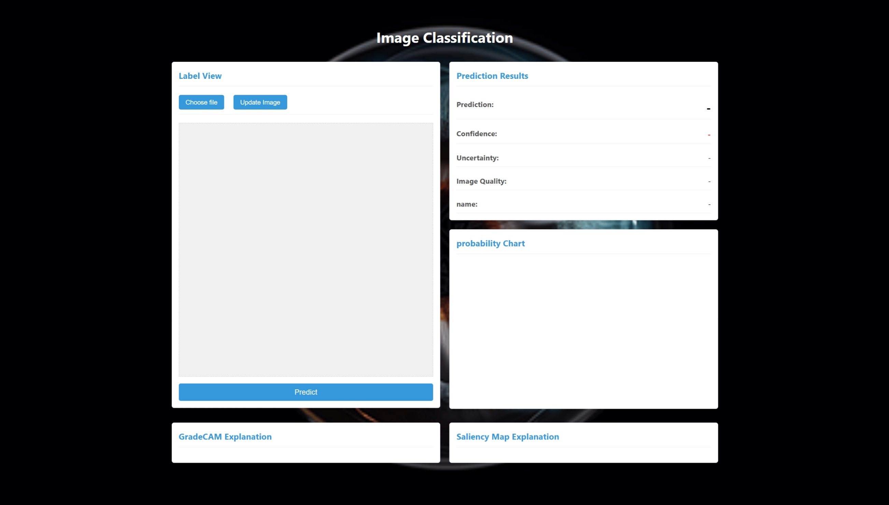
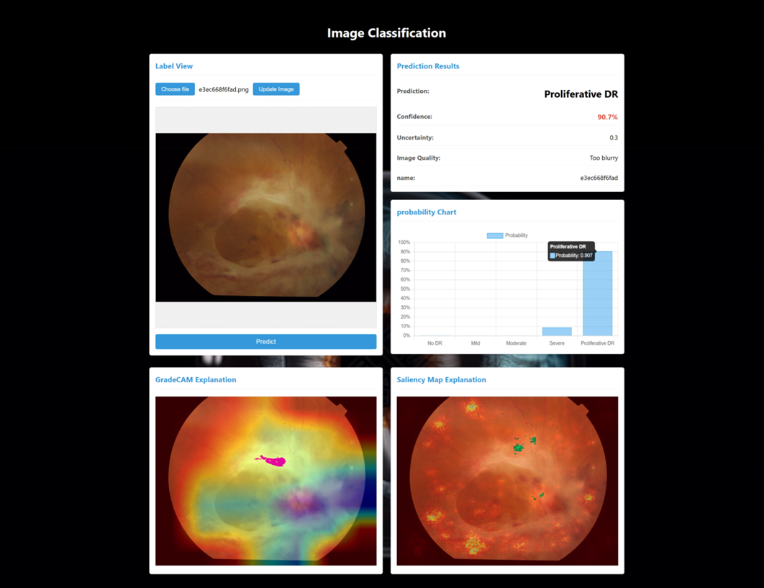
Li Tong (Aaron)
Classification of Diabetic Retinopathy using Residual Learning
with a Custom Balanced Softmax Loss
Oxford Brookes University in collaboration with Chengdu University of Technology
Supervised by Dr. Happy Nkanta Monday
Abstract
This study proposes a ResNet-based deep learning model for Diabetic Retinopathy (DR) classification, using Balanced Softmax Loss to address class imbalance and incorporating SE blocks, wavelet transforms, and attention mechanisms to enhance feature extraction. The model achieved micro-average accuracies of 0.83 (5-class) and 0.87 (4-class) on the APTOS 2019 dataset, with macro-average accuracies of 0.73 and 0.84, respectively. Interpretability was improved using XAI techniques (LIME, Grad-CAM, SHAP). The model was deployed as a real-time web application, demonstrating potential for early DR diagnosis and clinical decision support.
Dataset
Model Structure
This study proposes a deep learning model integrating ResNet blocks, SE modules, learnable wavelet transforms, MHA, and FFN to address class imbalance and improve accuracy through multi-level feature extraction and enhanced selection.
Number of images within APTOS 2019 Blindness Detection (public)
To address class imbalance, this project uses a Balanced Softmax loss function. It removes the Softmax activation from the output layer and adjusts the loss by adding the logarithm of class sample counts to the logits, giving higher weights to minority class errors during training to improve their recognition.
Different Classes of Diabetic Retinopathy
Preprocessed and Augmented Diabetic Retinopathy Classes
Multi-Scale Attention Residual Network
Balanced Softmax loss function
The APTOS 2019 dataset (3662 images) was split into training, validation, and test sets. The training set underwent augmentation (flipping, brightness adjustments, rotations) and preprocessing (center cropping, normalization) to address image artifacts and class imbalance.
Model evaluation
Model Visualization (XAI)
Training and Validation Accuracy Trends
Training and Validation Loss Trends
LIME
Gard-CAM
ROC-AUC Performance Evaluation
Confusion Matrix
Precision-Recall Curves
The above figures collectively demonstrate the model's training progress, classification performance, and evaluation metrics, providing a comprehensive overview of its effectiveness and reliability.
WEB APPLICATION DEVELOPMENT
A Graphical User Interface (GUI) was designed using Flask to deploy the trained model on a web platform. It allows users to upload retinal images and receive predictions.
SHAP
XAI techniques (LIME, Grad-CAM, SHAP) were used in this study to enhance the interpretability of the deep learning model, providing insights into its decision-making process for medical imaging.
Main Page
GUI
Future work
🔹 Pretrained model integration To boost classification accuracy and improve handling of class imbalance
🔹 Lightweight model exploration To reduce training time and enable faster, more efficient deployment.
🔹 Cross-dataset generalization To evaluate performance on other imbalanced medical image datasets.

